Slide 1

It’s Me Parrot Rakhy

Slide 2
basic sys Python + DBMS machine learning data science web development video editing ai expert tools network access

Slide 3
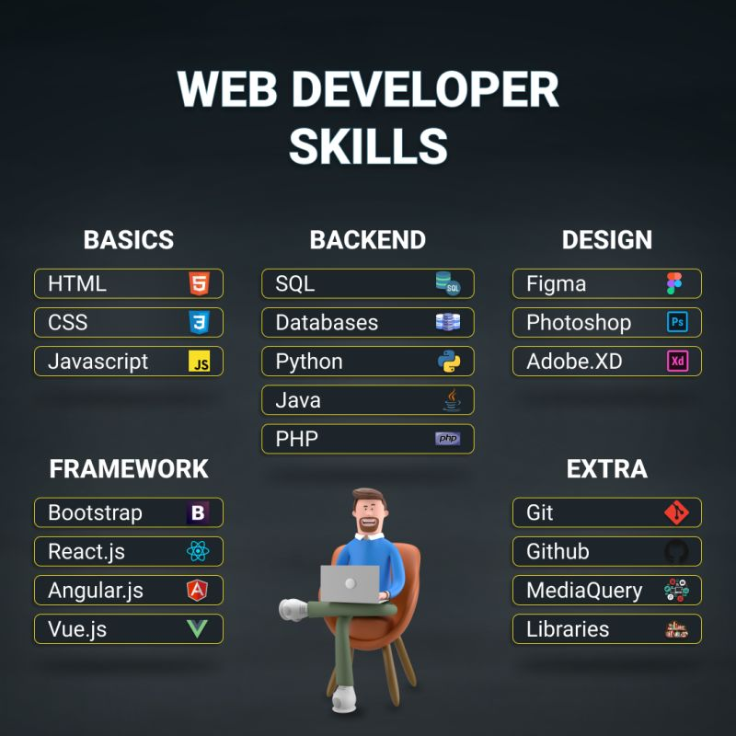

Slide 4
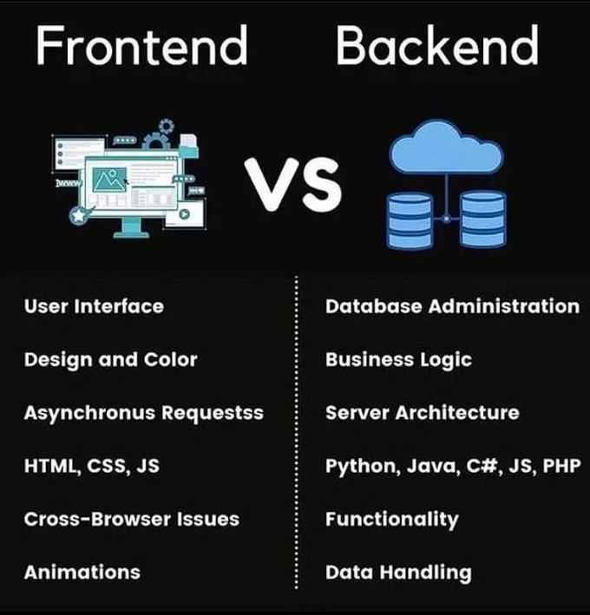

Slide 5
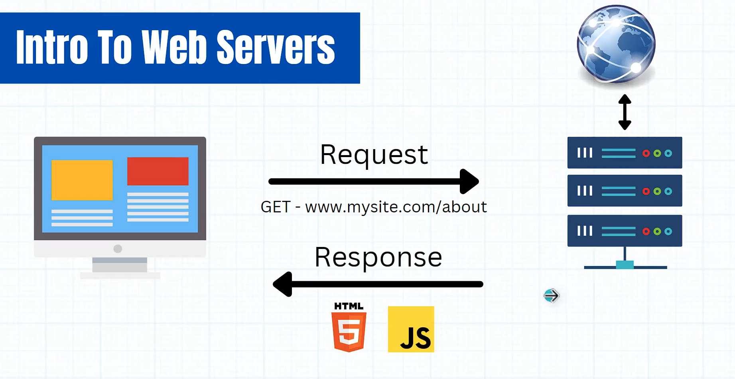

Slide 6
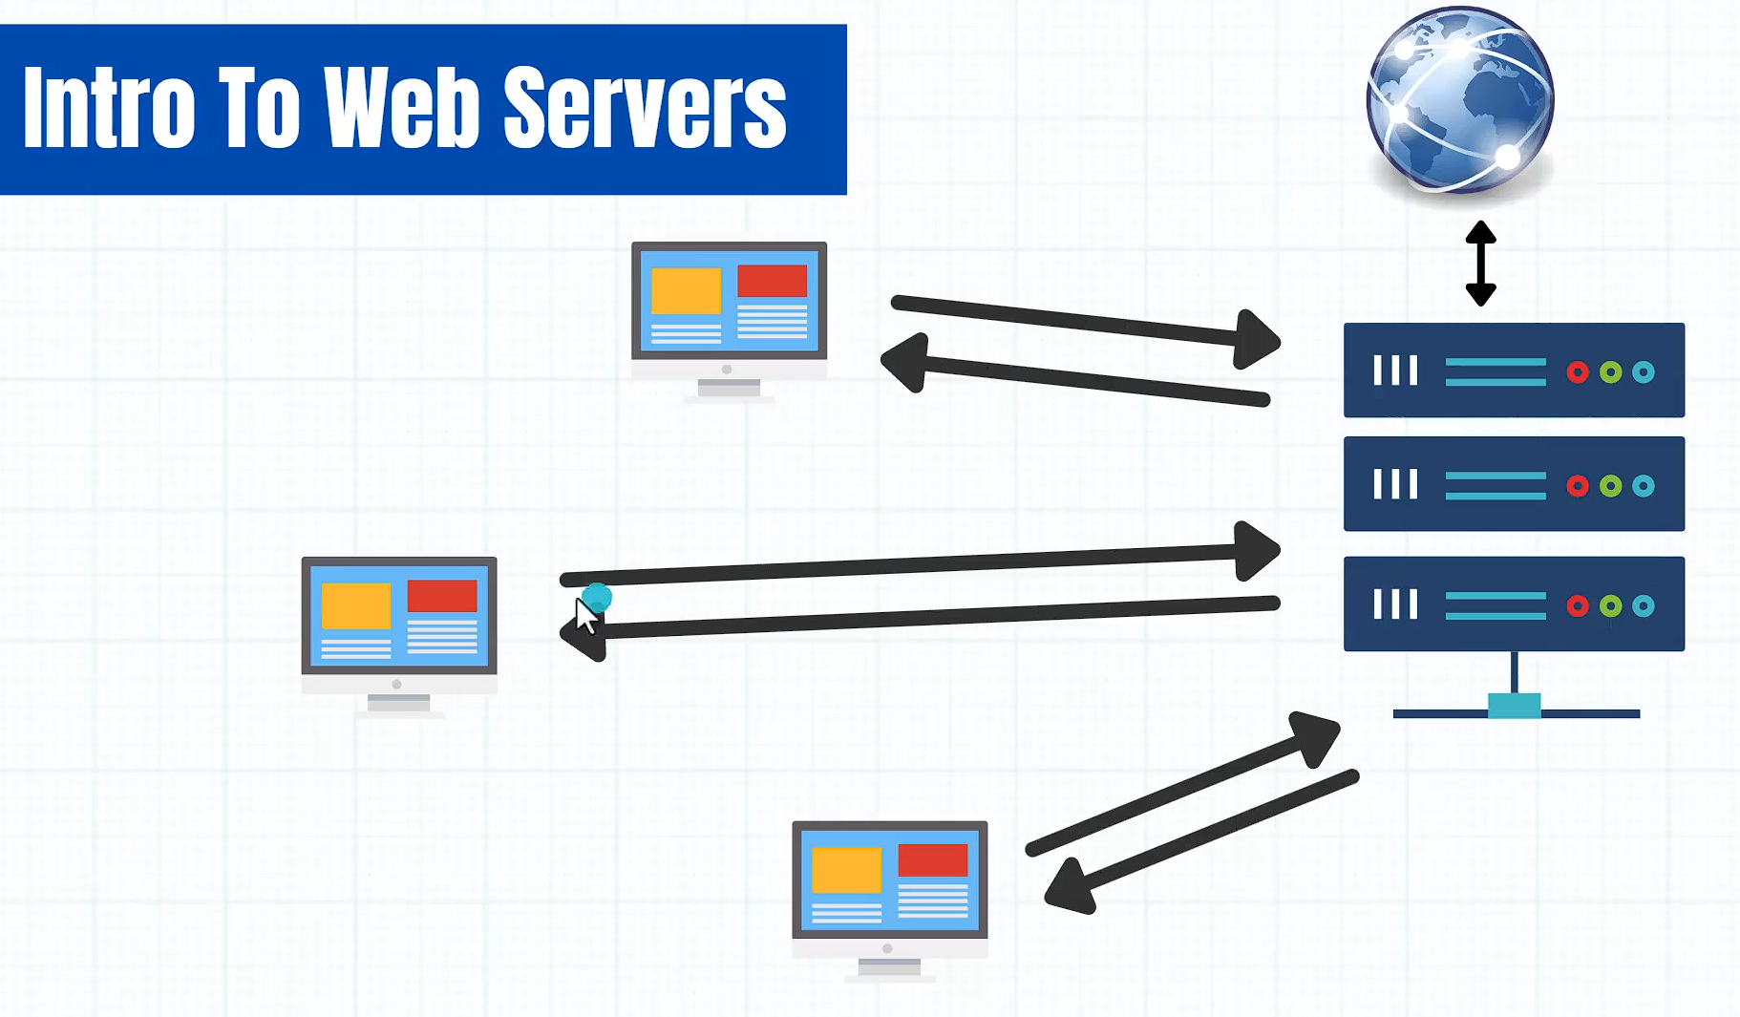

Slide 7
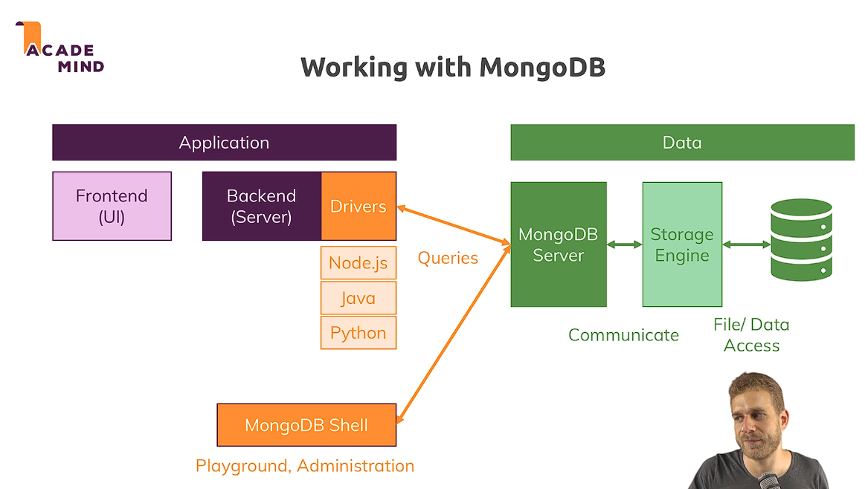

Slide 8
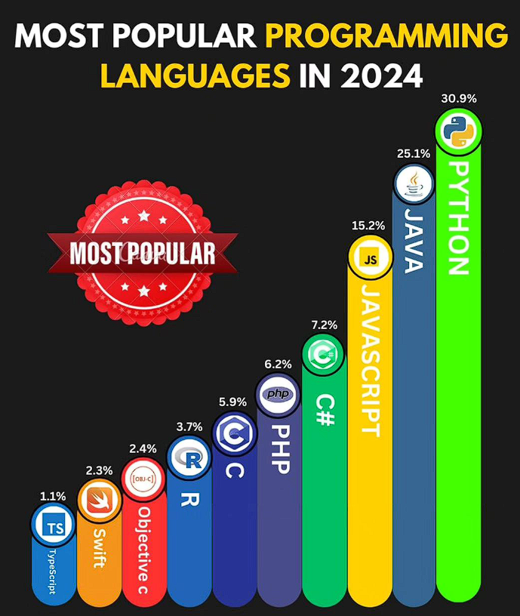

Slide 9
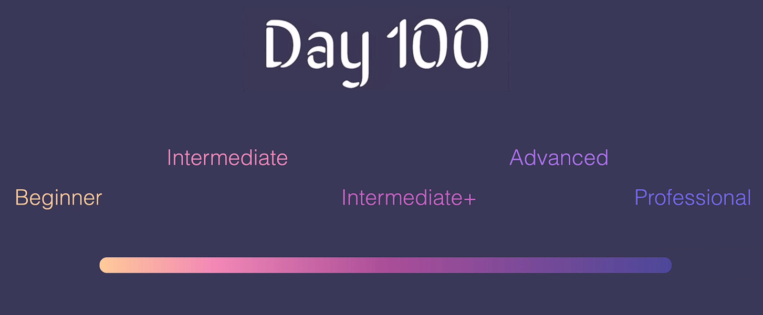

Slide 10
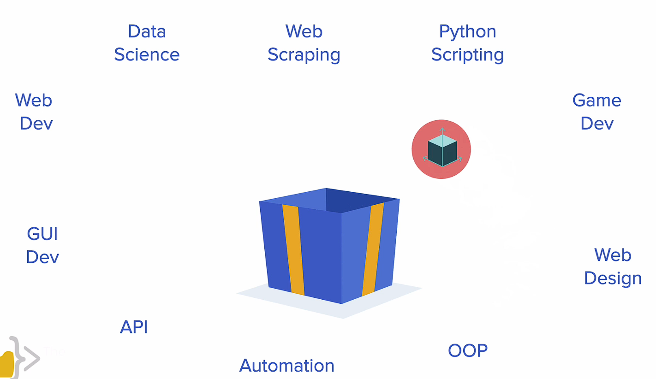

Slide 11
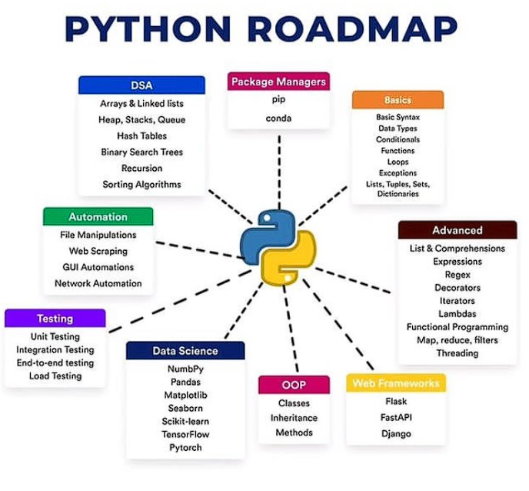

Slide 12
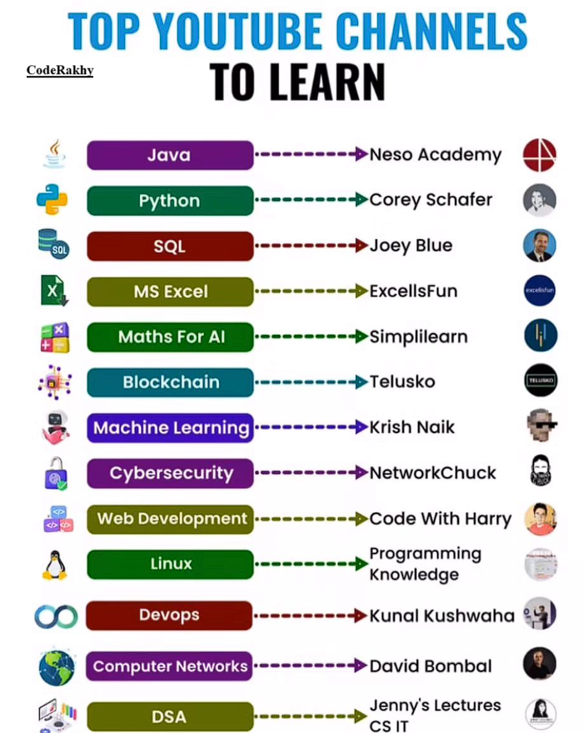

Slide 13
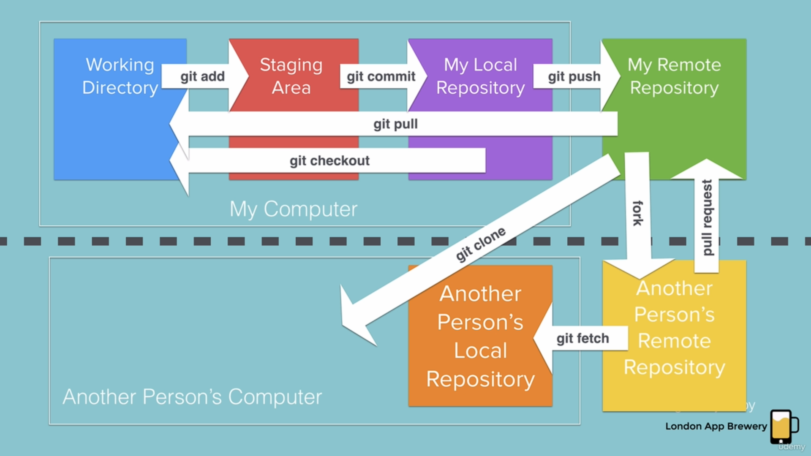
Git Commands

Slide 14
Ai tools

Slide 15
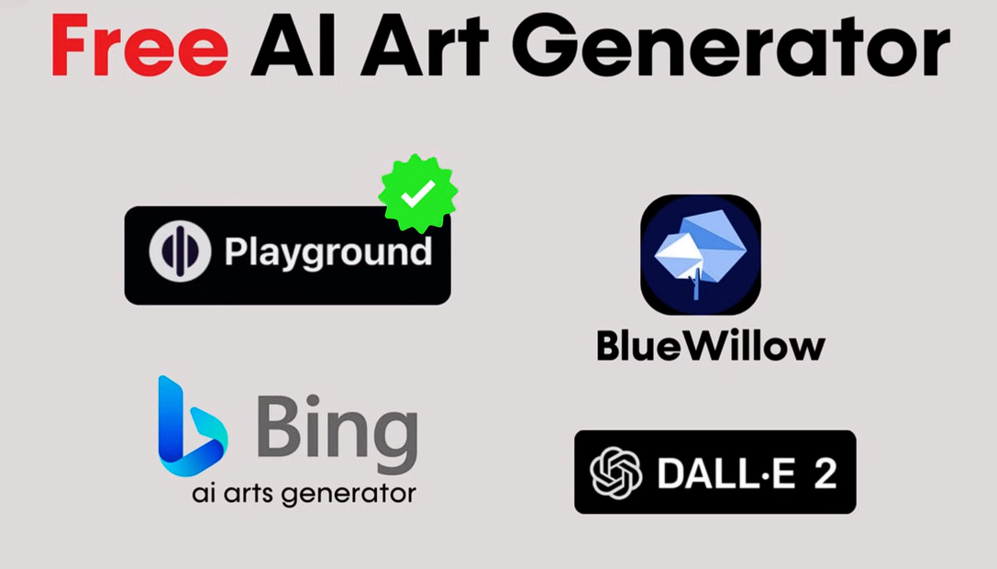

Slide 16


Slide 17
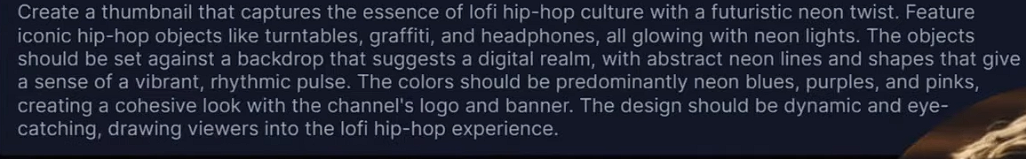
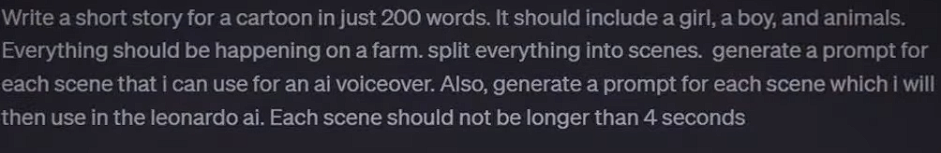
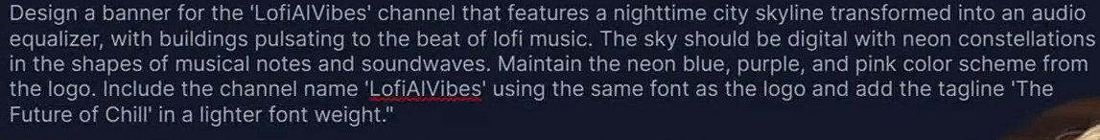
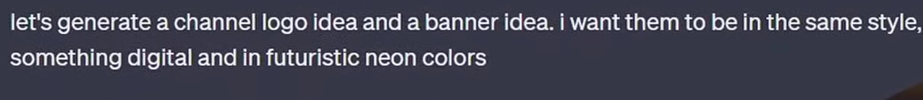
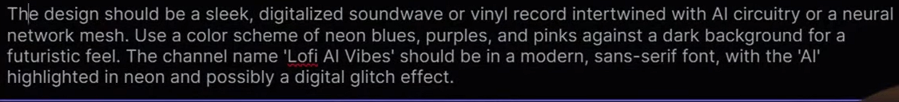
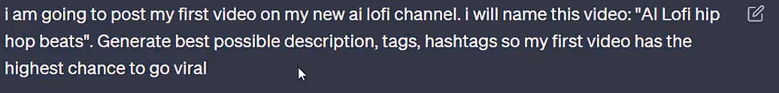

Slide 18
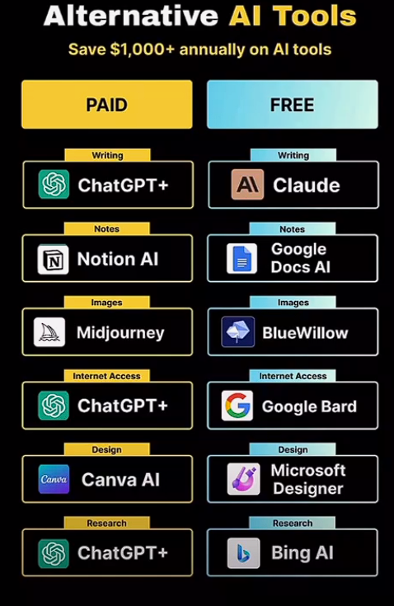

Slide 19
Tips & Tricks
Fake Emails
VPN security
Sharing Screens
Storing Data -- like Clouds
Searching Anyonmsoly – Tor Browser
Latest Updates related to AI and Stock or Financial related info etc. ( YT / Google)
Starting Your Business / YT Channel

Slide 20

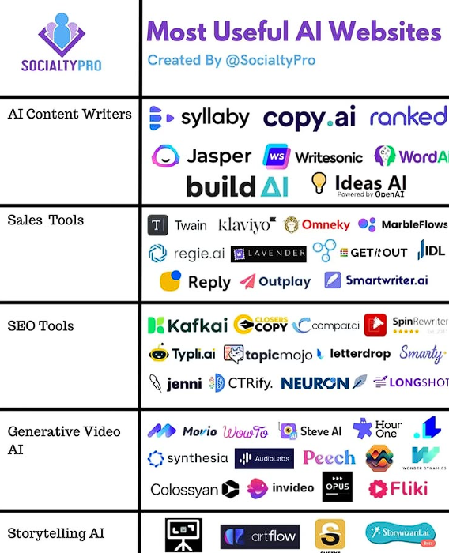
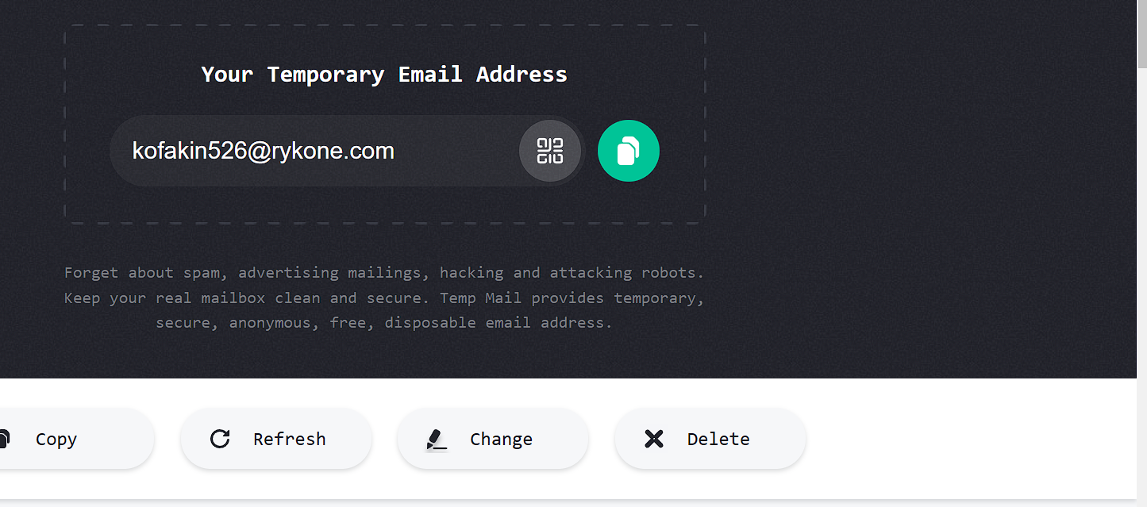





Slide 21
Resource links
If you feel like practicing your Python skills, check out these websites: https://codewars.com/
https://exercism.org/
https://leetcode.com/
https://hackerrank.com/
https://py.checkio.org/
https://www.codingame.com/

Slide 22
END

Slide 23
AI Tools
Day 1 – chatgpt ( ask anything you want)
Day 2 – suno.ai ( for music)

Slide 24
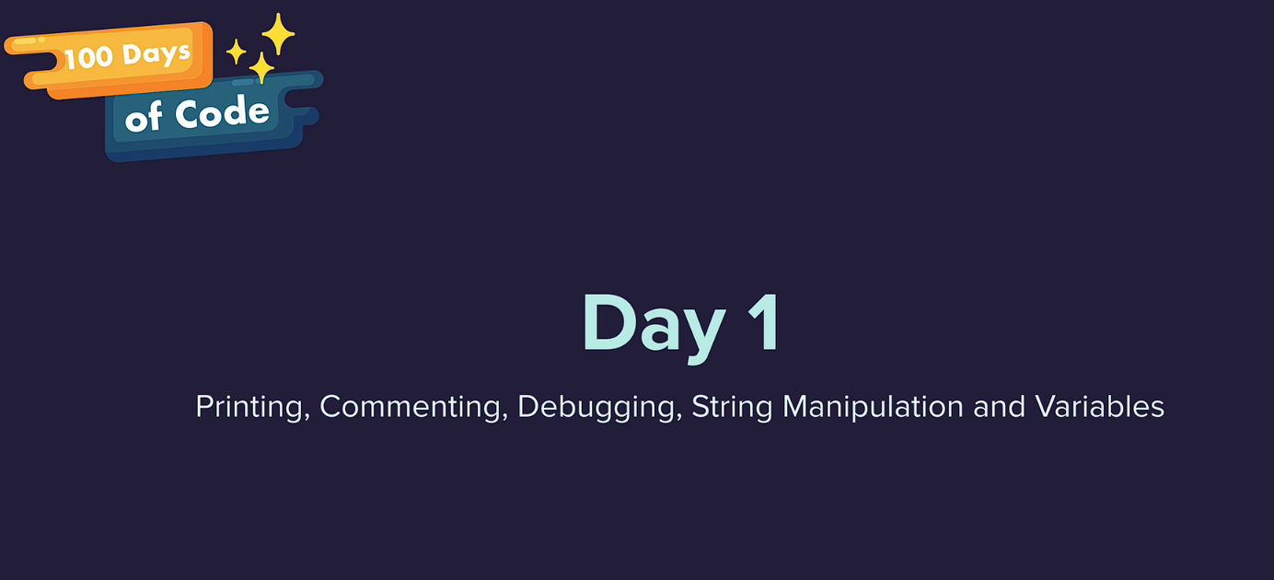

Slide 25
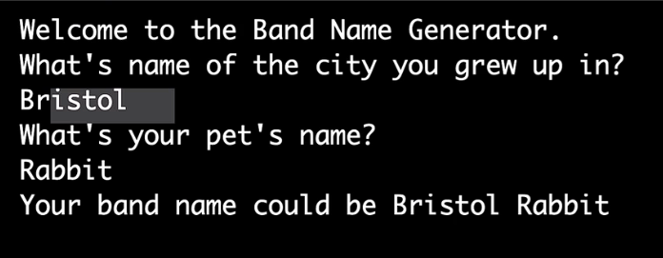
Day – 1 Project

Slide 26
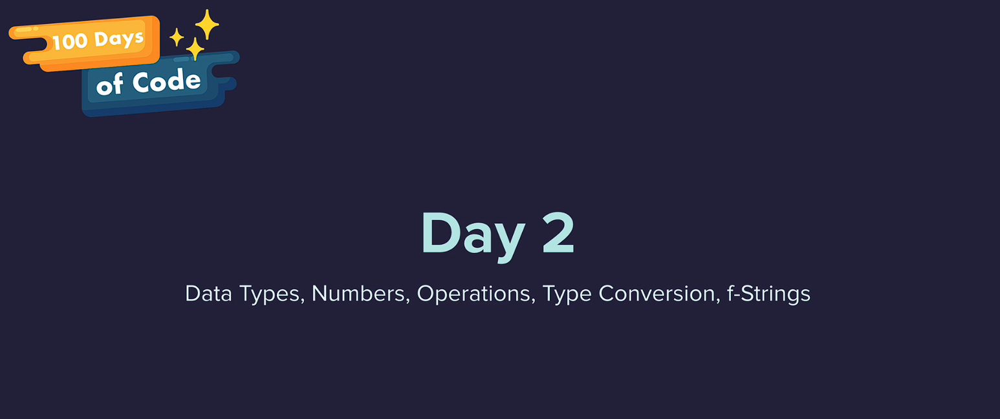

Slide 27
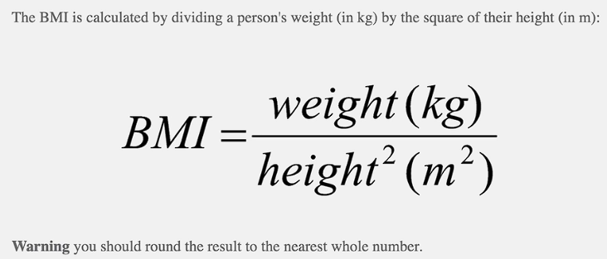
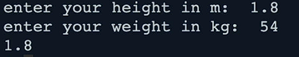
task

Slide 28
Task

Slide 29
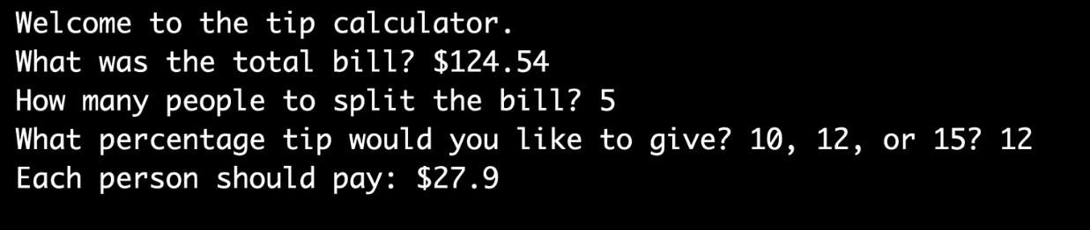
Day – 2 Project

Slide 30
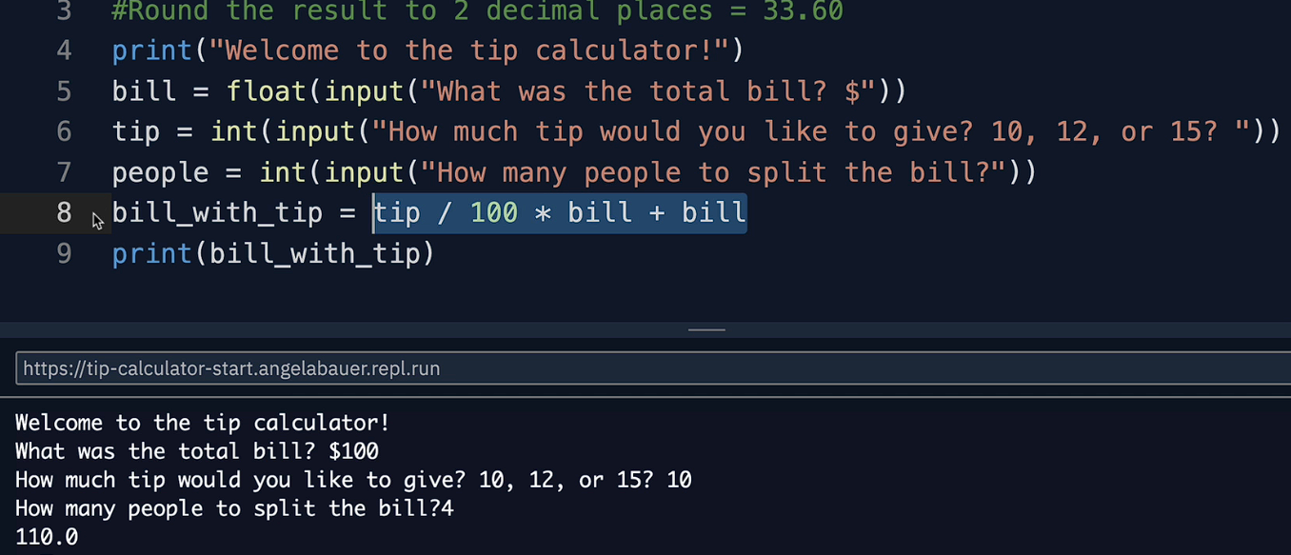
Solution

Slide 31
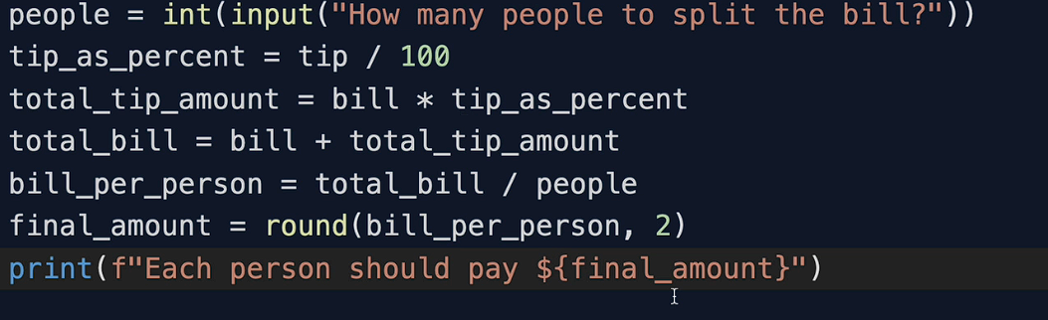
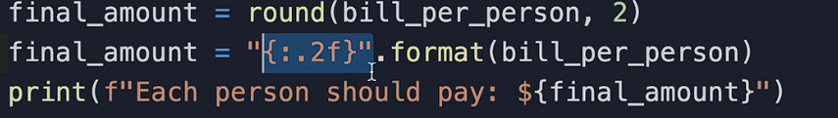
Another way solution - project 2

Slide 32
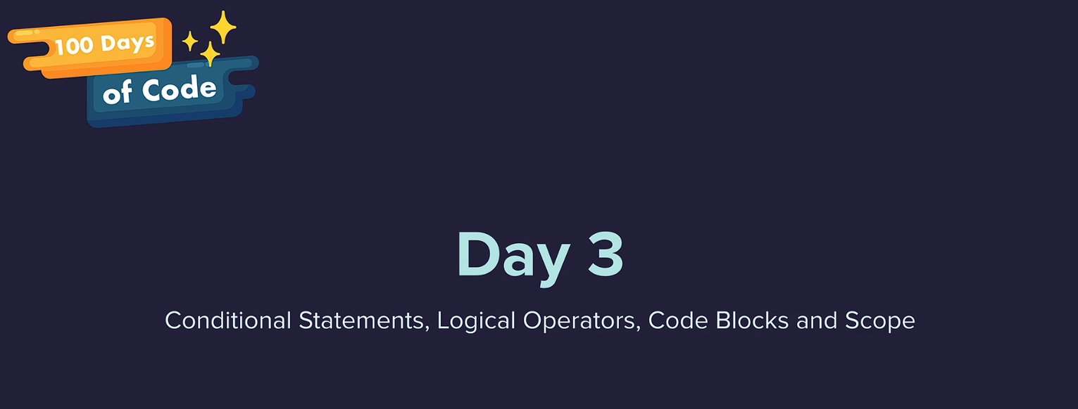

Slide 33

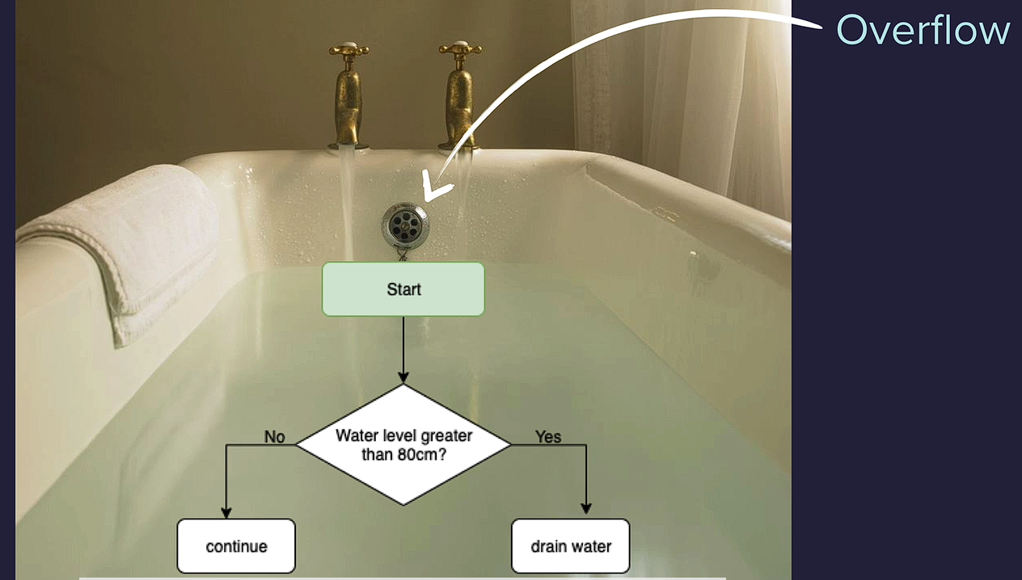
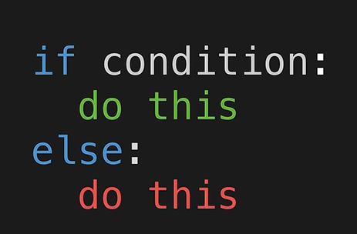

Slide 34
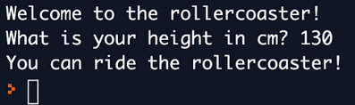
Task

Slide 35
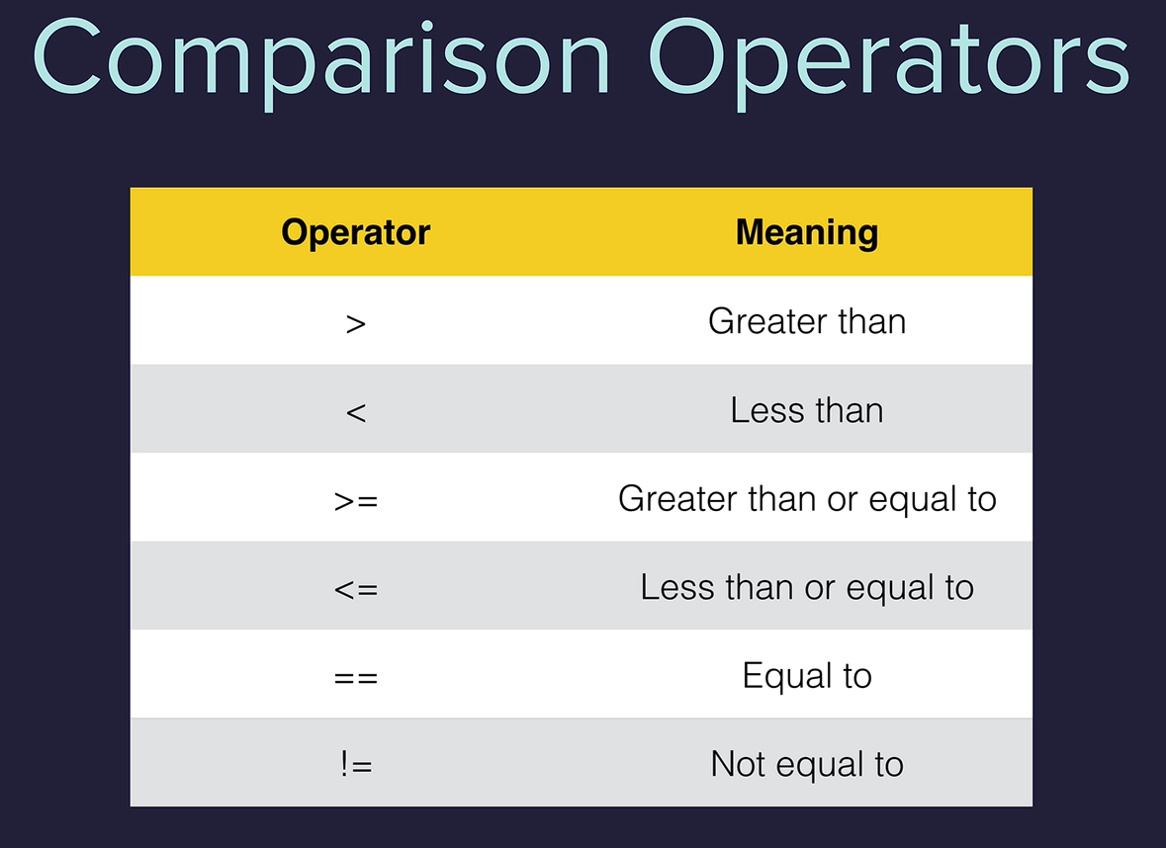

Slide 36
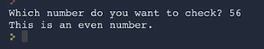
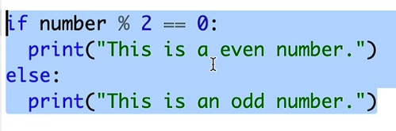

Slide 37
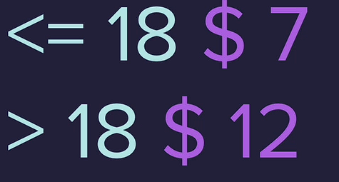
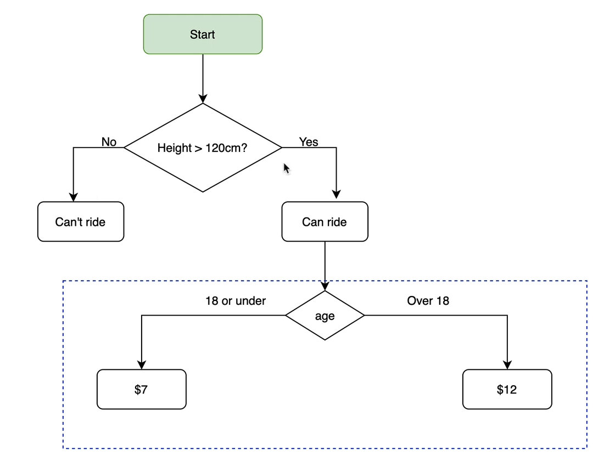
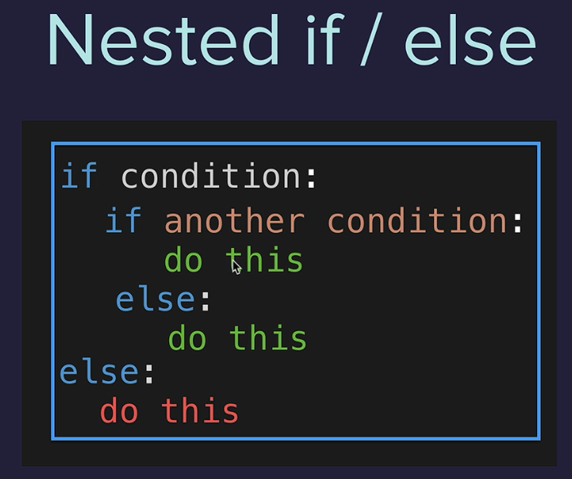
Nested if-else

Slide 38
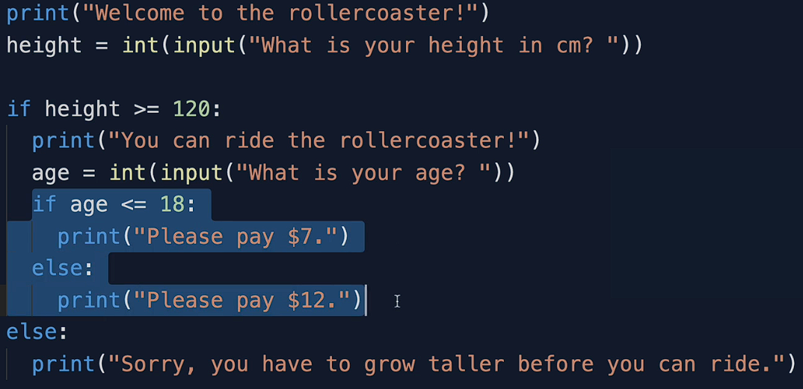
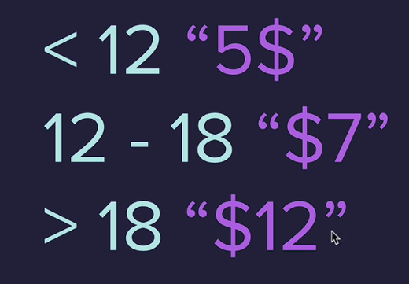
solution

Slide 39
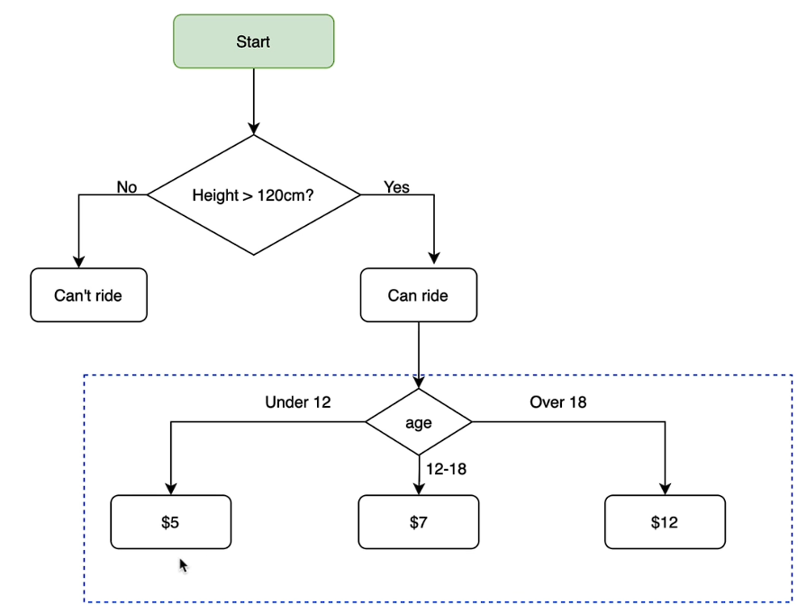
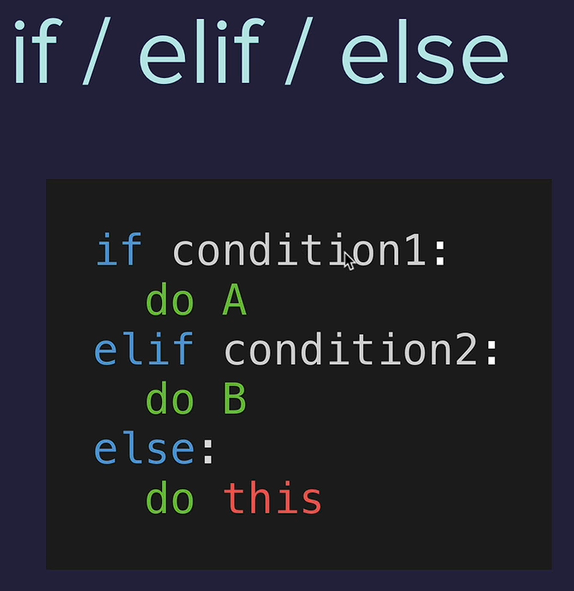

Slide 40
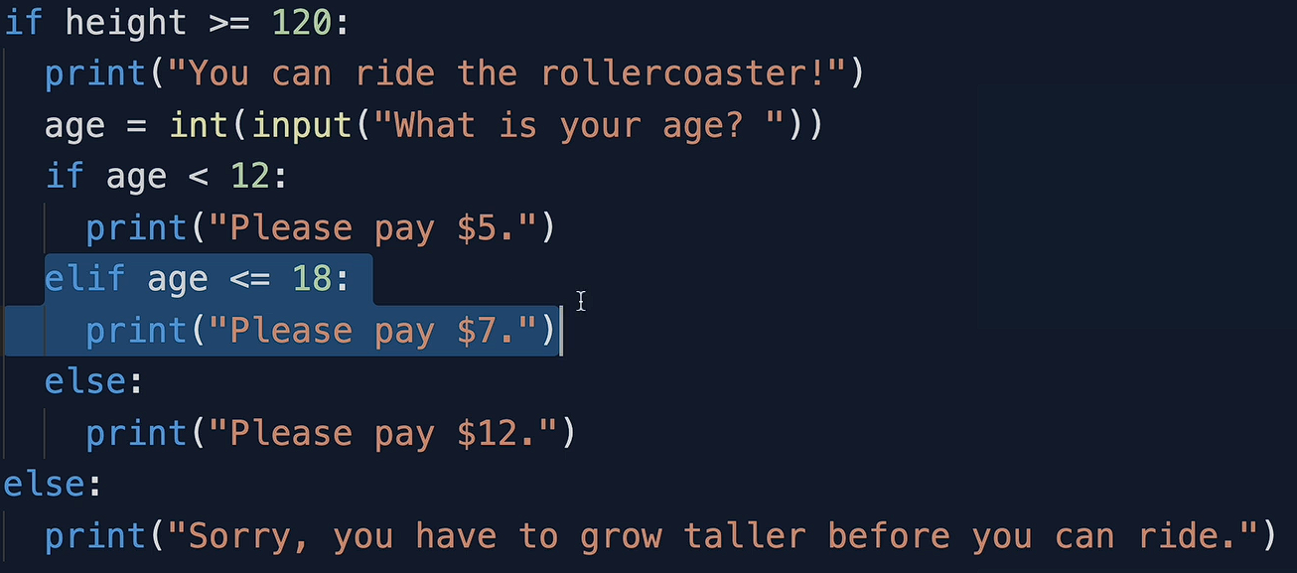
Solution

Slide 41

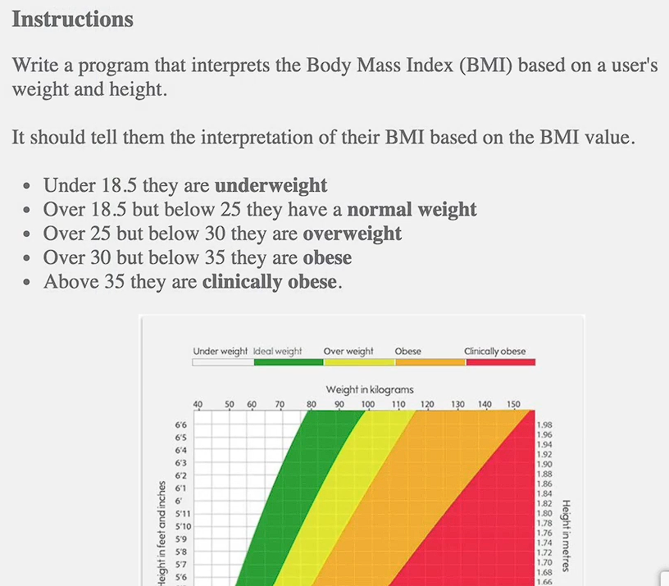
Task

Slide 42
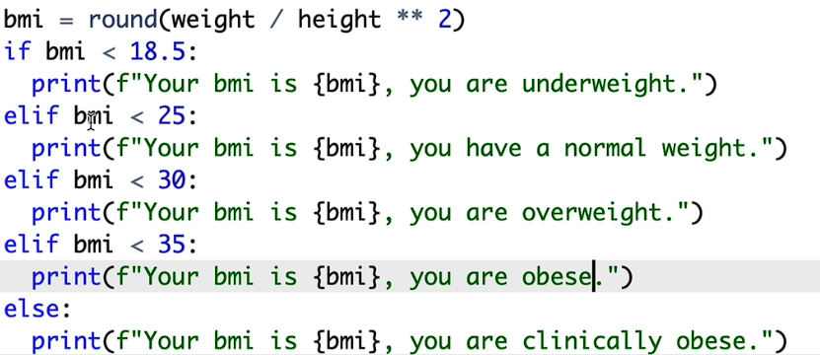
Solution
(observe the seps flow using – thonny site)

Slide 43

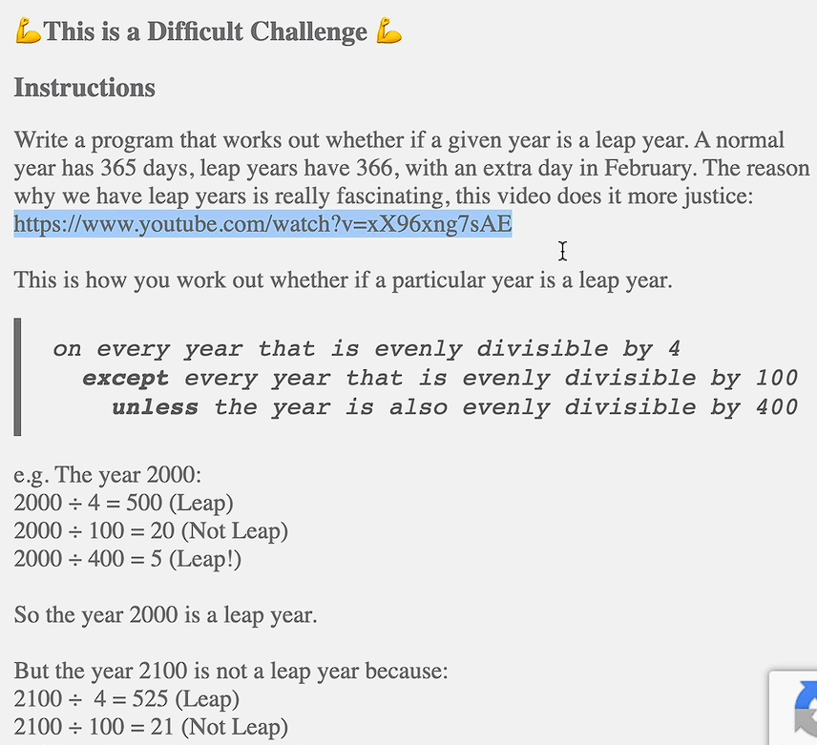
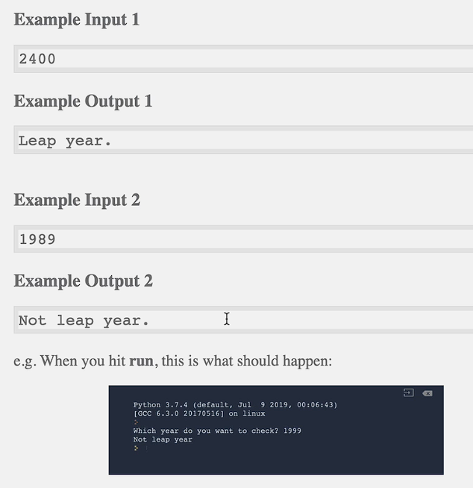
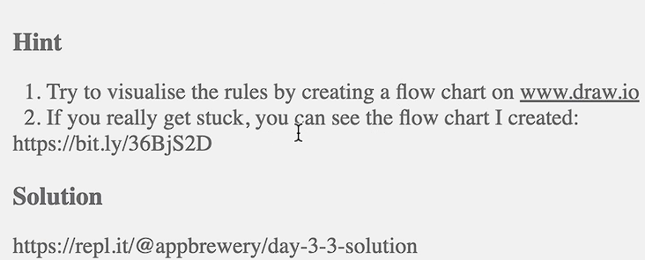
Difficult Task

Slide 44


solution

Slide 45

Multiple if conditions

Slide 46


Task (Ticket pricing)

Slide 47



Solution / output

Slide 48


Slide 49


solution

Slide 50



Logical Operators

Slide 51

Task

Slide 52



Slide 53



Hint & output

Slide 54


Solution

Slide 55


Day – 3 Project

Slide 56

Algorithm ( flow-chart)

Slide 57


Solution

Slide 58


Slide 59

Random numbers (import random)

Slide 60

Task

Slide 61

Data structures
Lists

Slide 62

String method

Slide 63

Nested lists

Slide 64



Day – 4 Project

